Slide 1
juk; - 07

Slide 2
njhlHghly; kw;Wk; jfty; ngWtjw;F ,izaj;jpidg;g gad;gLj;JthH
NjHr;rp 7

Slide 3
njhluwh kw;Wk; njhluW(kpd;dQ;ry;) njhlHghly;fisg; gad;gLj;JthH
NjHr;rp kl;lk; 7.2
ghlNtis - 02

Slide 4
kpd;dQ;ry; E-Mail
,yf;f tbtpyike;j nra;jpnahd;iw xU fzpdp gaeupdhy; fzpdp tiyaikg;gpD}lhf mDg;Gtjw;Fk; xd;W my;yJ xd;Wf;F Nkw;gl;l gadhsHfspdhy; mr;nra;jpia ngw;Wf;nfhs;tjw;Fkhf gad;gLj;jg;gLk; xU fUtpNa kpd;dQ;ry; MFk;.

Slide 5
kpd;dQ;ry; xd;iw mDg;g my;yJ ngw;Wf;nfhs;s mtrpakhdit
fzpdp
,izaNrit toq;FeH (Internet Service Provider - ISP)
kpd;dQ;ry; fzf;F
kpd;dQ;ry; nkd;nghUs; (Eg: MS Outlook, Eudora, Pegasus, Pine)

Slide 6
kpd;dQ;ry; Kftup
kpd;dQ;riy mDg;GgtH> ngWeH Mfpa ,U jug;gpdUf;Fk; kpd;dQ;ry; Kftup ,Uj;jy; fl;lhakhdjhFk;.
kpd;dQ;riy gad;gLj;j Kd;dH kpd;dQ;ry; fzf;if Muk;gpj;jy; Ntz;Lk;.

Slide 7
kpd;dQ;ry; Kftup
xU kpd;dQ;ry; KftupahdJ ,U gFjpfisf; nfhz;L cUthf;fg;gl;ljhf fhzg;gL;k;.
gadhsH ngaH
Ms;fsg;ngaH
,it ,uz;Lk; @ vd;w milahsj;ijf; nfhz;L NtWgLj;jg;gl;bUf;Fk;.
cjhuzk;: mala20@gmail.com
sam32@yahoo.com
bama@hotmail.com

Slide 8
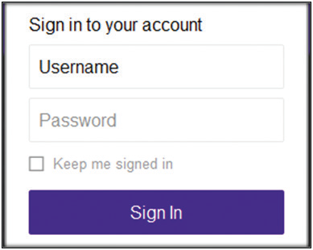
kpd;dQ;ry; fzf;fpw;F kpd;dQ;ry; KftupAk; (Email address) flTr;nrhy;Yk; (Password) ,Uj;jy; mtrpakhFk;.

Slide 9
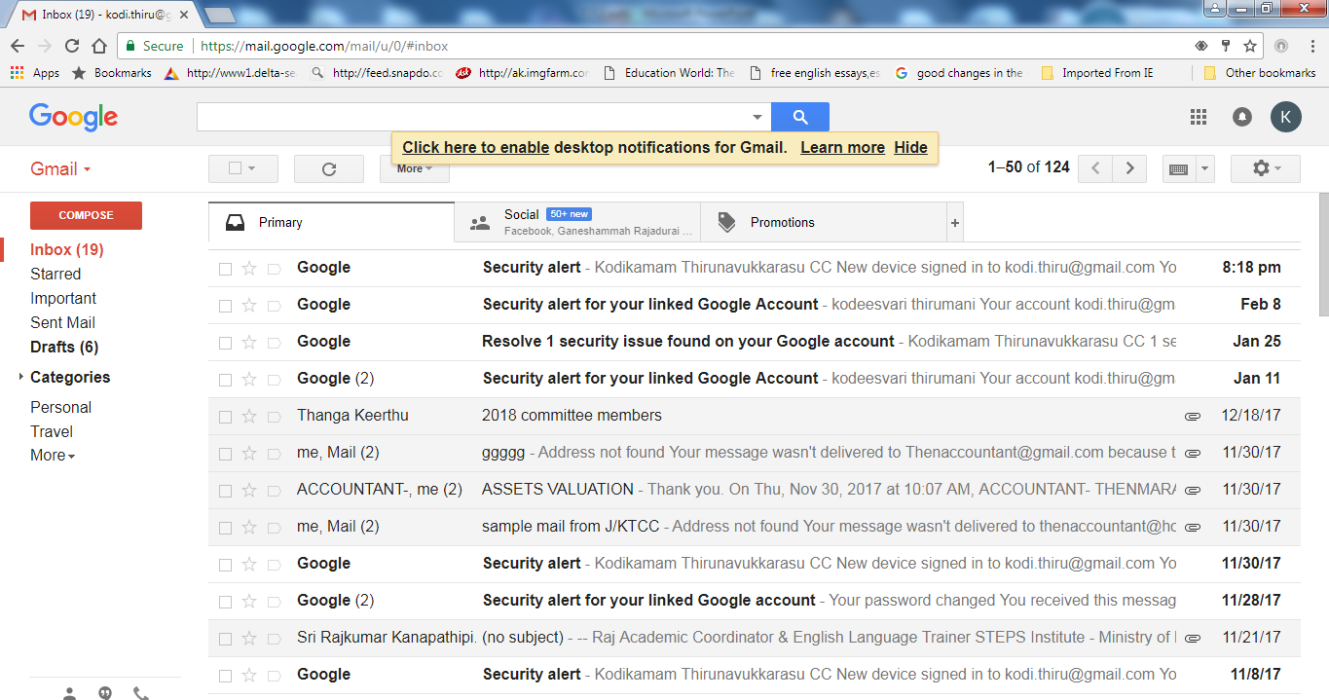
kpd;dQ;rypD}lhf fbjk; mDg;Gjy;

Slide 10
Gjpa kpd;dQ;riy mDg;Gk;NghJ Compose Button I Click nra;a Ntz;Lk;.

Slide 11
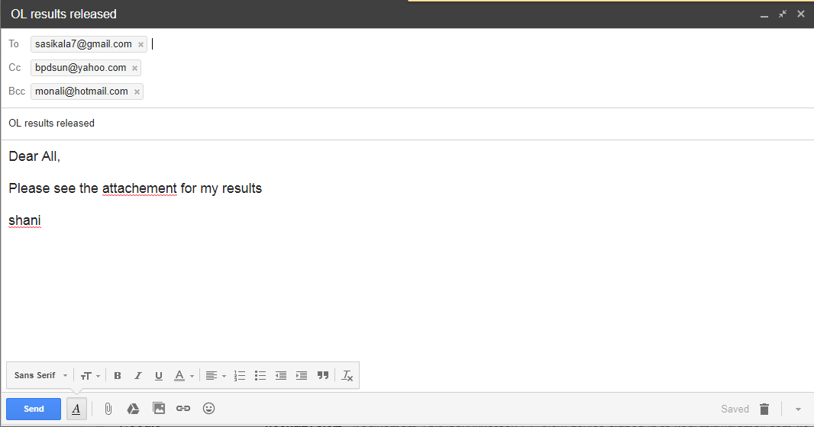
kpd;dQ;ry; nra;jpnahd;wpd; Kf;fpa gFjpfs;
tplak; / Subject
,izg;Gf;fs; / Attachement

Slide 12
kpd;dQ;ry; nra;jpnahd;wpd; Kf;fpa gFjpfs;
To: ,t;tplj;jpy; ngWeupd; kpd;dQ;ry; Kftupia Fwpg;gpl Ntz;Lk;.
Cc: Cc vd;gJ fhgd; gpujpiaf; (Carbon copy) Fwpf;Fk;. kpd;dQ;rypd; gpujpfis ,jD}lhf gyUf;F mDg;g KbAk;.
Bcc: Bcc vd;gJ njupahj fhgd; gpujpiaf; (Blind carbon copy) Fwpf;Fk;. kpd;dQ;rypd; gpujpfis kiwj;J mDg;Gtjw;fhf gad;gLj;jg;gLfpwJ. ,jd;gb Fwpg;gpl;l kpd;dQ;rypd; gpujp ahH ahUf;F mDg;gg;gLfpwJ vd;gJ kiwf;fg;gl;L ,Uf;Fk;.
Subject (tplak;): kpd;dQ;rypy; cs;slf;fg;gLfpd;w tplaj;ij RUf;fkhf jl;lr;R nra;jy; Ntz;Lk;.
Attachement (,izg;Gf;fs;): ,it kpd;dQ;ry; nra;jpAld; mDg;gp itf;fg;gLk; jdpj;j NfhitfshFk;.(glq;fs;> fbjq;fs;> rj;jq;fs;> tPbNahf;fs;)
Forward: ehk; ngw;Wf;nfhz;l kpd;dQ;rnyhd;iw NtnwhUtUf;F mDg;g Forward gad;gLk;.
Reply (gjpy;): ehk; ngw;Wf;nfhz;l nra;jpAld; mr;nra;jpf;fhd gjpiyAk; ,izj;J kPz;Lk; mDg;g (Reply) gjpy; gad;gLk;.

Slide 13
kpd;dQ;riy jahH nra;j gpd;dH Send vd;Dk; Button I Click nra;Ak;NghJ cupatiu nrd;wilAk;.

Slide 14
kpd;dQ;ry; xd;wpy; fhzg;gLk; milTfs;
Inbox: ,q;F ngwg;gLk; kpd;dQ;ry;fs; Nrkpf;fg;gl;bUf;Fk;.
Draft: mDg;Gtjw;nfd jahH nra;J KOikg;gLj;jg;glhj fbjq;fs; Nrkpf;fg;gl;bUf;Fk;.
Outbox: mDg;gg;gl;l kpd;dQ;ry; cupatiu nrd;wilAk; tiu jw;fhypfkhf ,q;F Nrkpf;fg;gl;bUf;Fk;.
Sent : mDg;gg;gl;l fbjq;fs; Nrkpf;fg;gl;bUf;Fk;.
Trash/Deleted : mopf;fg;gl;l fbjq;fs; Fwpg;gpl;l fhyj;Jf;F Nrkpf;fg;gl;bUf;Fk;.
Spam/Junk: Njitaw;w fbjq;fs; Nrkpf;fg;gl;bUf;Fk;.

Slide 15
njhluwh fye;Jiuahly; (Online Conferencing)
ntt;NtW ,lq;fspYs;s ,UtH my;yJ gyUf;F ,ilapy; xyp> xsp juTfis CLflj;jp fzpdp tiyaikg;gpD}lhf fye;Jiuahliy Nkw;nfhs;sy; njhluwh fye;Jiuahly; vdg;gLk;.

Slide 16
njhluwh fye;Jiuahliy Nkw;nfhs;s mtrpakhdit
,izaj; njhlHGldhd fzpdpfs;
tiyf;fkuh
njhlHghly; nkd;nghUs; (xyp> xsp trjpfSld;)

