Slide 1
juk; - 07

Slide 2
njhlHghly; kw;Wk; jfty; ngWtjw;F ,izaj;jpidg;g gad;gLj;JthH
NjHr;rp 7

Slide 3
,izaj;jpy; fpilf;ff;$ba tsq;fis gad;gLj;JthH(ghlk;> gbkk;> fhnzhsp Nghd;wd)
NjHr;rp kl;lk; 7.1
ghlNtis - 01

Slide 4
,izak; vd;why; vd;d?
cyfpYs;s fzpdpfis tiyaikg;gpd; Clhf xd;Wld; xd;W ,izj;J cUthf;fg;gLk; tiyg;gpd;dy;fs; ,izak; MFk;.

Slide 5
WWW - cyfshtpa tiy
,J ,izaj;jpd; Nritfspy; xd;whFk;.
,J ,izaj;Jld; njhlHGgl;l cyfshtpa fzpdpfspy; Njf;fg;gl;Ls;s ,yj;jpudpay; Mtzq;fspd; ghupa njhFg;ghFk;.
WWW vd;gjd; tpupT WORLD WIDE WEB vd;gjhFk;.

Slide 6
URL- rPuhd ts ,Ug;gplq;fhl;b
,J tiyf;flg;gplq;fspYs;s ,d;Ndhud;d tsq;fis jdpj;Jtkhf ,dq;fhz gad;gLfpwJ.
URL vd;gjd; tpupT UNIFORM RESOURCE LOCATOR vd;gjhFk;.

Slide 7
URL ,d; gFjpfs;

Slide 8
ghlk;> gbkk;> fhnzhsp Nghd;wtw;iw gjptpwf;fk; nra;jy;
Njlw;nghwpapid gad;gLj;jp gpd;tUk; topfspy; gjptpwf;fk; nra;Jnfhs;s KbAk;.
ghlk;
gpujp nra;J xl;Ljy;(Copy Paste nra;jy;) my;yJ PDF Mtzkhf gjptpwf;fk; nra;jy;.
gbkq;fis gjptpwf;fk; nra;a
Right click on image→Save as
All video Downloader, youtube downloader Nghd;w apps ,id gad;gLj;jp fhnzhspfis gjptpwf;fk; nra;ayhk;.

Slide 9
G+Nfhs tiuglj;jpid mZfy;
Google Njlw;nghwpapid gad;gLj;jp Earth Map ,id NjLjy;.
,jd; %yk; njU tiuglq;fs;> njUf;fspd; 360º
ghHl;bkpf; ghHit(Street view) epfo;Neu Nghf;Ftuj;J epyikfs; kw;Wk; fhy;> fhH> kpjptz;b> my;yJ nghJ Nghf;Ftuj;J Mfpatw;Wf;fhd gaz topfis ngw KbAk;.

Slide 10
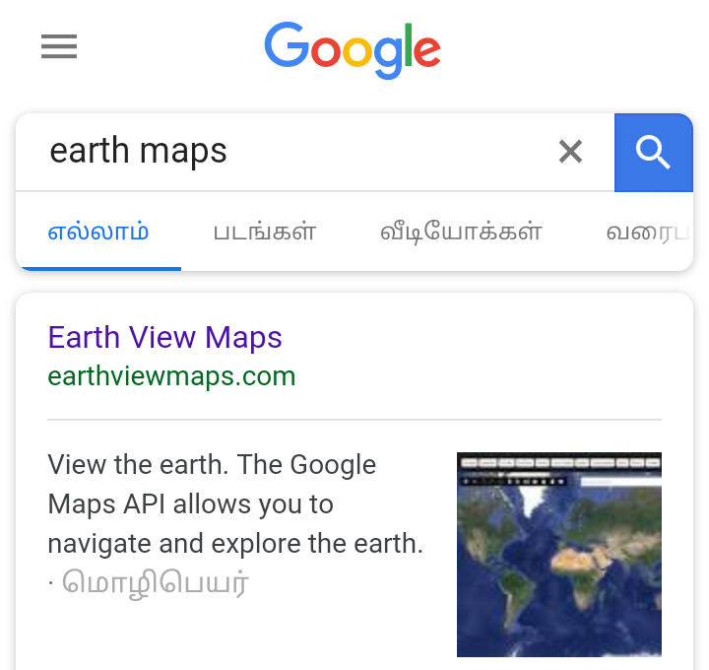

Slide 11
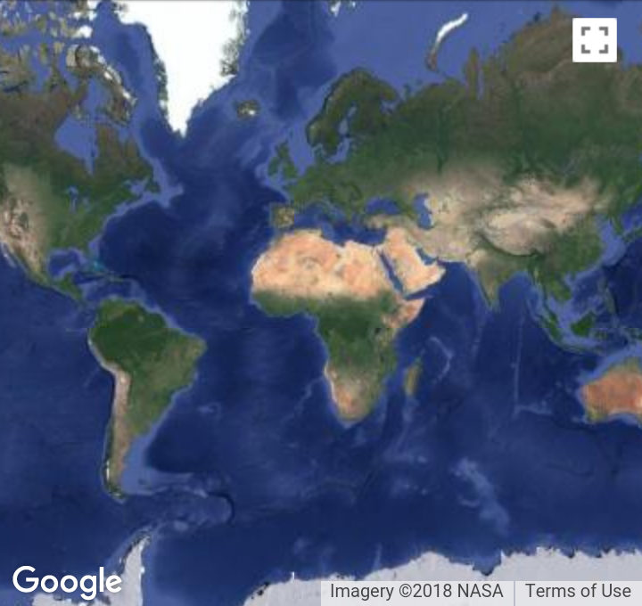

Slide 12
ek;gfkhd kw;Wk; ek;gfkw;w tiyj;jsq;fis ,dq;fhz;gJ vt;thW?
Internet Security Software(,iza ghJfhg;G nkd;nghUs;) ,id fzpdpapy; epWTtjd; %yk; ek;gfkhd kw;Wk; ek;gfkw;w tiyj;jsq;fis ,dq;fhz KbAk;.

Slide 13
ek;gfkhd kw;Wk; ek;gfkpy;yhj jfty;fs;
,izaj;jpd; %yk; ngwg;gLk; jfty;fs; vg;NghJk; cz;ikahditahf fhzg;glhJ.
murhq;f kw;Wk; murhq;fj;jhy; mq;fPfupf;fg;gl;l ,izaj;jsq;fspYs;s jfty;fs; ek;gfj;jd;ikAiladthf fhzg;gLk;.
ek;gfkpy;yhj juTfisf;nfhz;bUf;Fk; ,izaj;jsj;jpw;F cjhuzkhf www.wikipedia.org ,idf;nfhs;syhk;. fhuzk; ,t; ,izaj;jsj;jpy; midtUk; jfty;fis gjpT nra;Ak; mDkjpiaf; nfhz;bUg;gjdhyhFk;.

Slide 14
The End

